Slide 1

Module 7: RNA-sequencing
Ximena Ibarra-Soria
GSK
ximena.x.ibarra-soria@gsk.com
Based on materials by Victoria Offord.
Next Generation Sequencing Bioinformatics Course
18-22 January - Santiago - Chile
FACULTAD DE
CIENCIAS BIOLOGICAS
PONTIFICIA UNIVERSIDAD CATOLICA DE CHILE

Slide 2
Overview
RNA-seq background.
Experimental design.
Data alignment.
Quantification.
Normalisation.
Differential expression.
Interpretation of results.
http://www.macmillanhighered.com/BrainHoney/Resource/6716/digital_first_content/trunk/test/morris2e/asset/img_ch3/morris2e_ch03_fig_03_03.html

Slide 3
RNA-sequencing
Uses high-throughput sequencing to profile the transcriptome of a biological sample at a given time.
Transcriptome = set of RNA molecules present in a cell.
Allows to
Catalogue all species of transcripts (messenger, small, non-coding).
Annotate the structure of genes (start, end, splice isoforms, UTRs).
Compare the types and quantities of the RNA molecules across time and conditions.
Wang, Gerstein and Snyder, Nat Rev Genetics 10 (2009) doi.org/10.1038/nrg2484

Slide 4
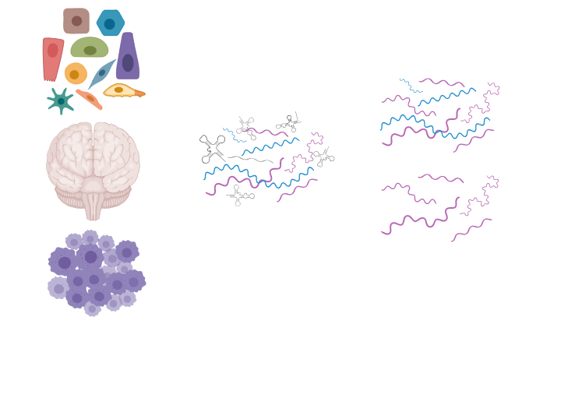
RNA-sequencing
mRNA
reverse-transcription
ribo-depletion
cDNA
adapter ligation
cDNA library
adaptors
amplification and sequencing
sequence reads
rRNA
polyA RNA
non-polyA RNA
mapping to genome
polyA selection
ORF
coding sequence
mapped sequence reads
biological sample
total RNA
RNA of interest
>80% is rRNA
Modified from Wang, Gerstein and Snyder, Nat Rev Genetics 10 (2009) doi.org/10.1038/nrg2484

Slide 5
Experimental design
Start by identifying what is the question to answer and what type of information is required.
Single vs paired-end (isoform analysis).
Stranded vs unstranded (antisense and overlapping transcripts).
Sequencing depth (detection of low abundance transcripts).
Number of replicates:
Biological = independent, biologically distinct samples.
Technical = repeated measurement of the same sample.
For differential expression analysis, increasing the number of replicates is better than increasing depth.
Liu, Zhou and White, Bioinformatics 30 (2014) doi:10.1093/bioinformatics/btt688

Slide 6
Experimental design
Start by identifying what is the question to answer.
Consider what are possible sources of variation.
Biological: sex, age, genetic background, ethnicity…
Technical: sample processing date, reagent’s batch, time of sample collection…
To estimate variation we need biological replicates.
Power calculations.
Number of replicates needed to observe an effect.
gene expression
control
treatment

Slide 7
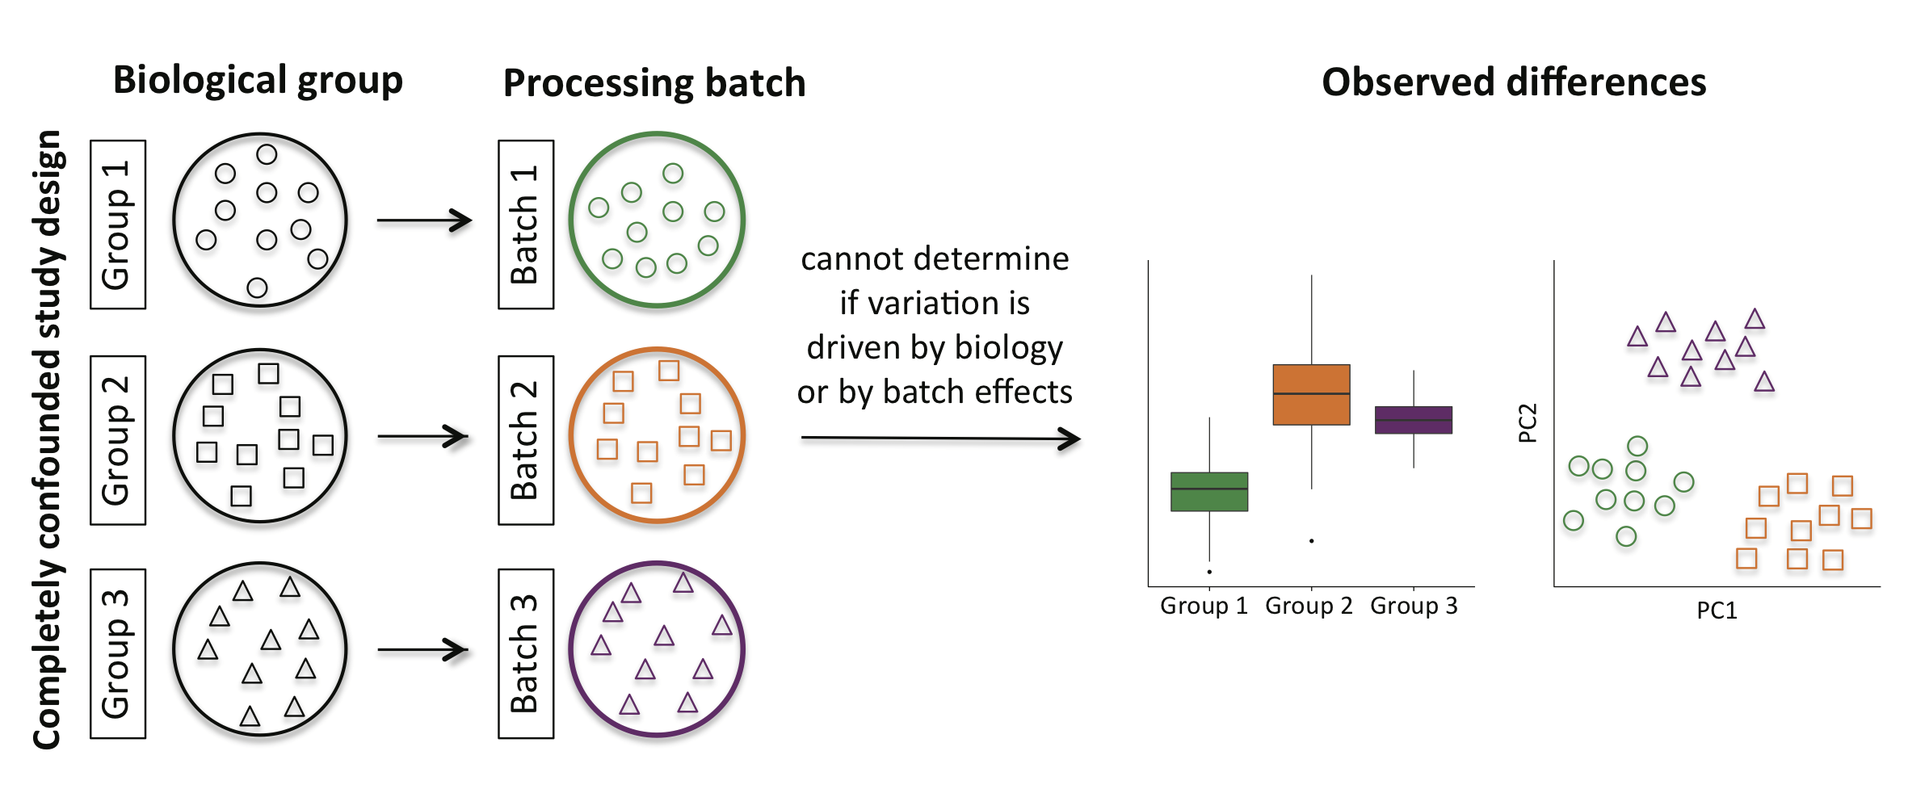
Experimental design
Adapted from Hicks et al., BioRxiv, version from December 27, 2015 - 06:15
doi.org/10.1101/025528

Slide 8
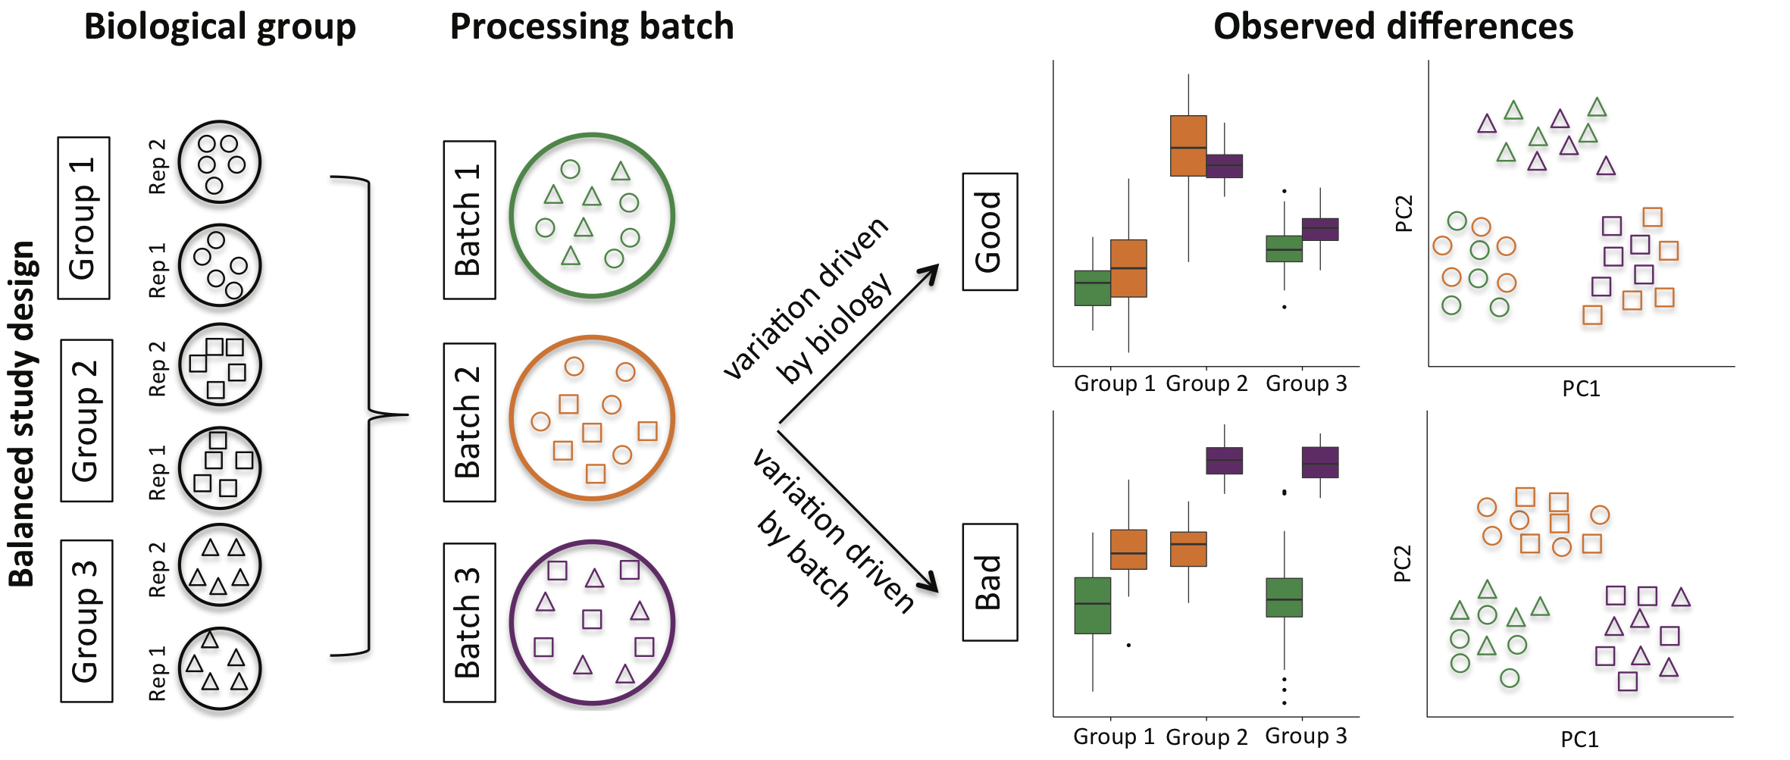
Experimental design
Adapted from Hicks et al., BioRxiv, version from December 27, 2015 - 06:15
doi.org/10.1101/025528

Slide 9
RNA-seq data analysis pipeline
sequencing reads
TopHat, STAR, HISAT2
Salmon, Kallisto
alignment to genome/transcriptome
de novo transcript assembly
Cufflinks, Trinity, Oases
featureCounts, HTSeq, STAR, Kallisto
counting reads in features
There is no universal pipeline adequate for all experiments.
Different datasets and biological questions will require different analyses and will influence which programs and parameters are chosen.
edgeR, DESeq2, limma-voom, sleuth
differential expression and other analyses

Slide 10
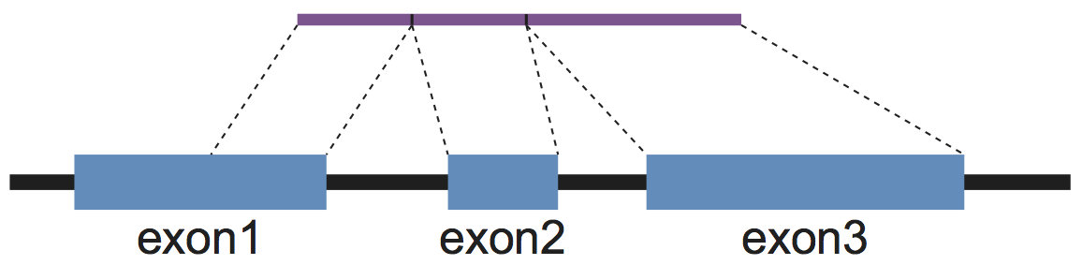
RNA-seq data alignment
RNA-seq reads come from spliced mRNAs.
Therefore, their alignment in the genome is interrupted by introns.
Two solutions:
Map reads to the transcriptome instead of the genome.
Allow gapped alignments.
read
genome

Slide 11
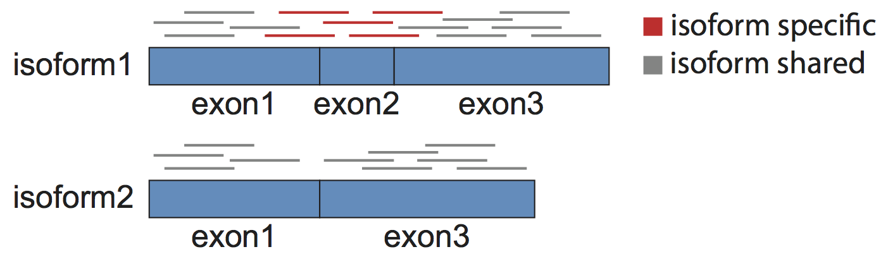
Map to the transcriptome
If the RNA-seq reads are mapped to the transcriptome, reads in exons that are shared across transcript isoforms will map multiple times.
Only possible for organisms with a well-annotated transcriptome.
Any novel genes or isoforms will be lost.

Slide 12
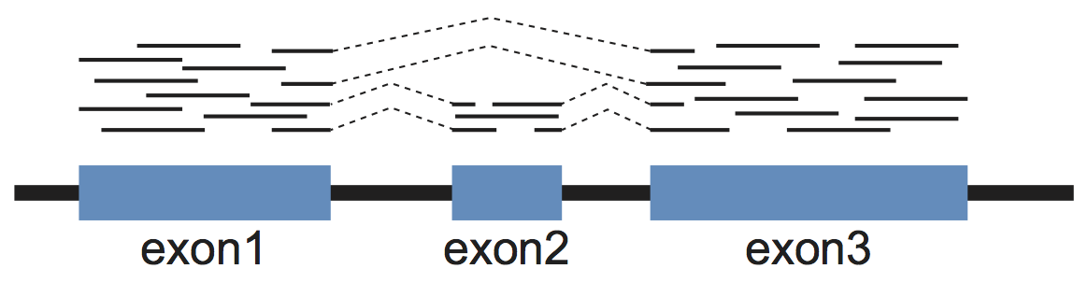
Map allowing large gaps
Instead, we can map to the genome but allowing the alignments to have large gaps.
Intron size ranges from 10² to ~10⁵ in eukaryotes.
Many different mappers.
TopHat, STAR, HISAT2, GSNAP, subread, MapSplice.

Slide 13
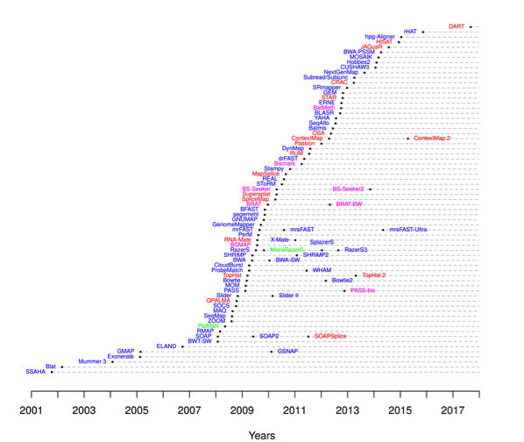
RNA-seq data aligners
There are many different programs to align RNA-seq data.
There is no best aligner.
Memory usage.
Speed.
Accuracy of splice junction detection.
Simulation-based comprehensive benchmarking of RNA-seq aligners.
Baruzzo et al., Nat Methods 14 (2017) doi.org/10.1038/nmeth.4106
DNA
RNA
https://www.ebi.ac.uk/~nf/hts_mappers/

Slide 14
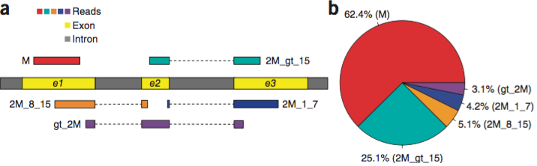
HISAT2
Fast and requires low memory.
Combines the Burrows-Wheeler transform and the FM index.
Two indices: one global FM index of the whole genome.
many small overlapping FM indices of 56kb-long regions.
Spliced alignment anchors:
>15bp long
8-15bp intermediate
1-7bp short
Reads (100bp)
Exon
Intron
Kim, Langmead and Salzberg, Nat. Methods 12 (2015) doi.org/10.1038/nmeth.3317

Slide 15
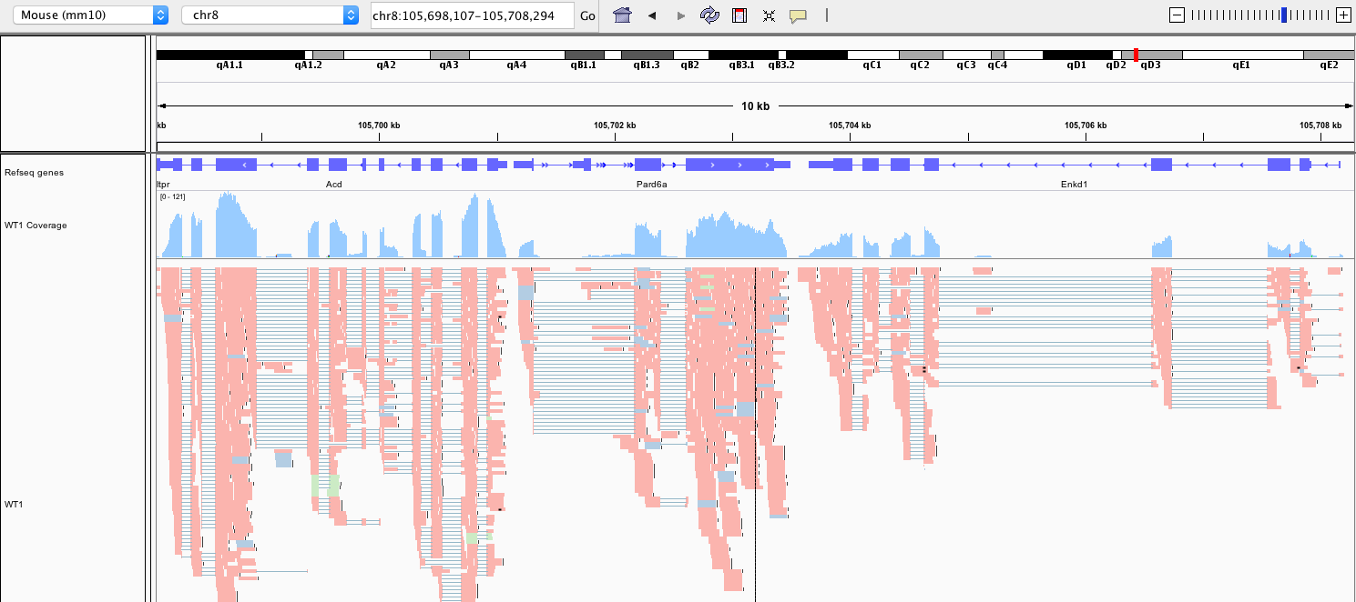
Visualisation of aligned RNA-seq reads
colour alignments by: tag
In this case reads are coloured by the NH tag, indicating the number of alignments:
unique two valid alignments three valid alignments …
http://software.broadinstitute.org/software/igv/
Notes:
RNAseq data mapped with STAR to the mouse genome.
Reads are coloured by tag. The first tag indicates the number of alignments of the read. Red are unique alignments, blue have two alignments, green three and so on.

Slide 16
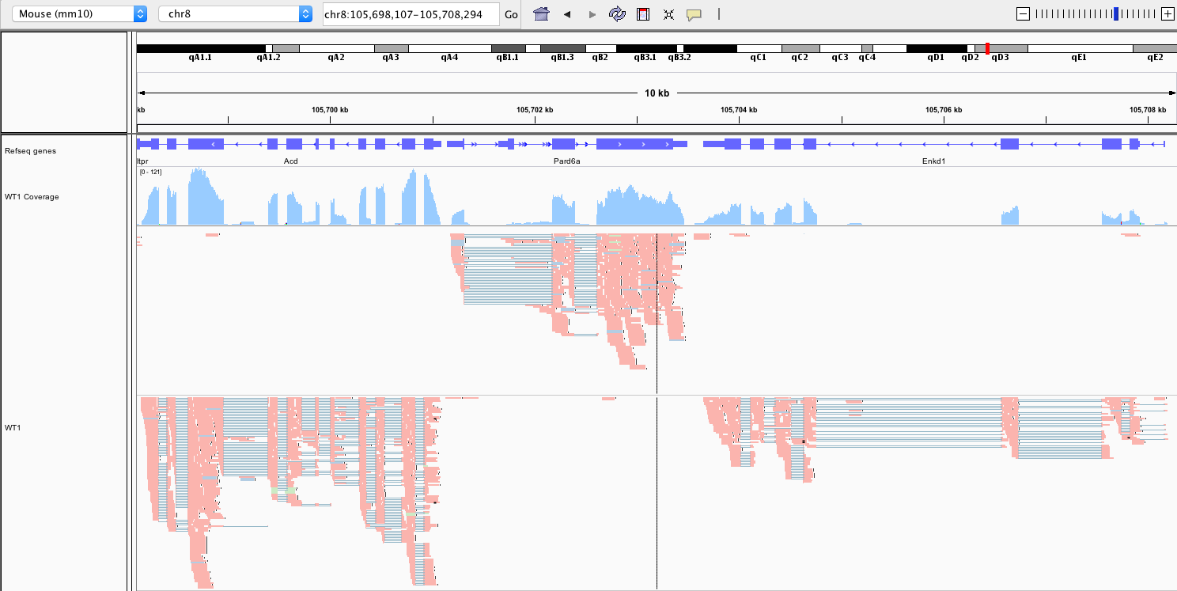
Visualisation of aligned RNA-seq reads
For stranded data
group alignments by: first-in-pair strand
http://software.broadinstitute.org/software/igv/

Slide 17
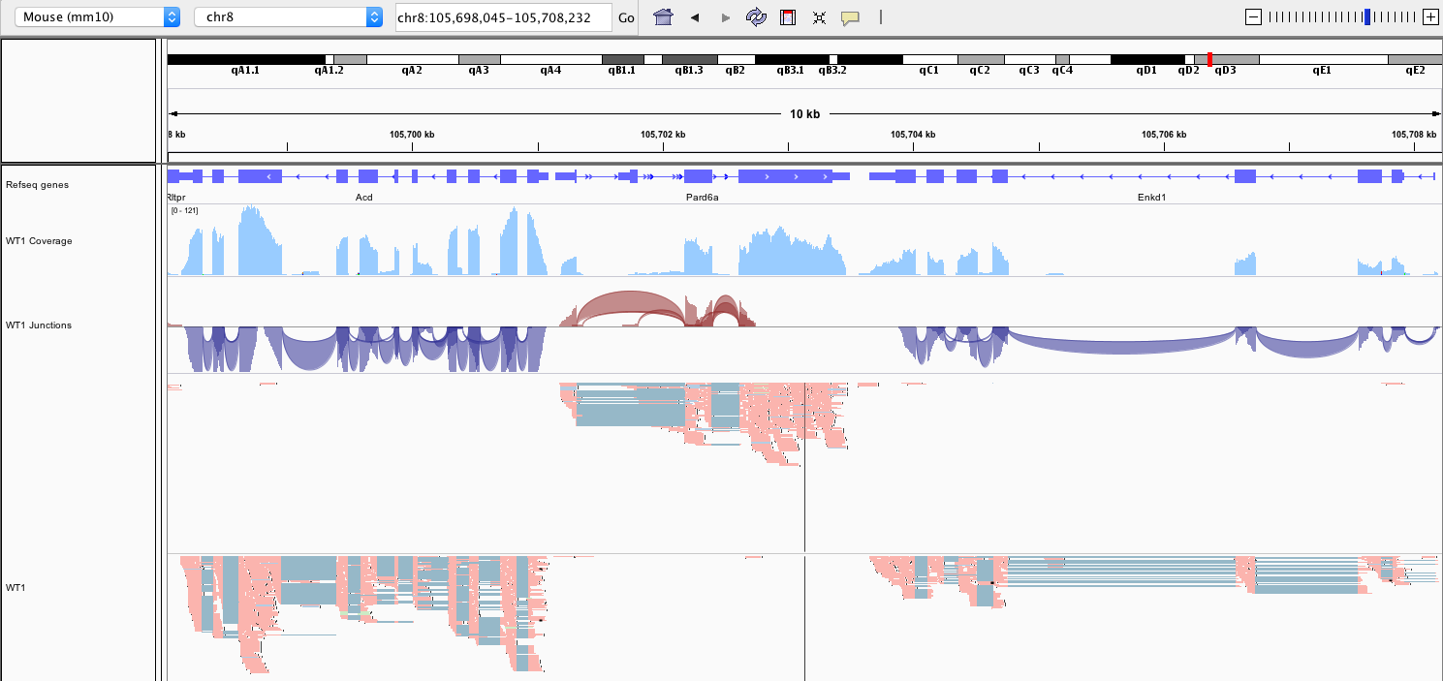
Visualisation of aligned RNA-seq reads
junctions track
http://software.broadinstitute.org/software/igv/

Slide 18
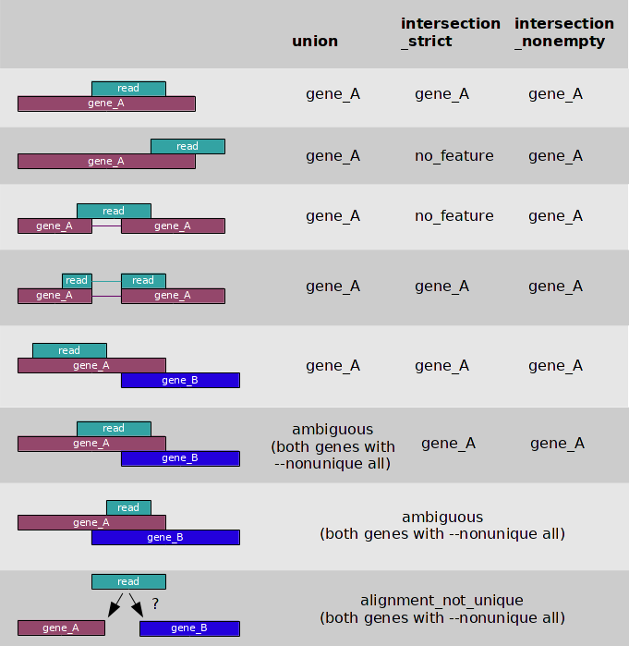
Quantifying reads in features
Once reads have been aligned to the genome, we want to quantify how many overlap features of interest (genes).
number of reads ∝ transcript abundance
Many available programs to do this (take a BAM and an annotation file).
HTSeq, FeatureCounts.
Some aligners also do the quantification while mapping.
STAR, Kallisto.
https://htseq.readthedocs.io/en/release_0.9.1/count.html

Slide 19
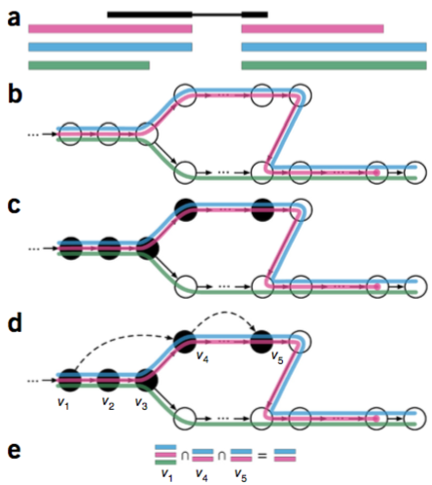
Quantification through pseudo-alignment
Quantification of gene expression doesn’t require knowing where a read originated from, but which transcripts could have generated it.
Kallisto uses this principle to pseudo-align RNA-seq reads.
de Bruijn graph to represent the transcriptome.
exact matching of k-mers from reads to identify their compatibility with a set of transcripts.
Pseudo-aligned reads are used to quantify the abundance of each compatibility class.
Bray et al., Nat Biotech 34 (2016) doi.org/10.1038/nbt.3519
Notes:
- Kallisto -
Accurate quantification doesn’t require knowing where in the transcript a read originated from, but which transcripts could’ve generated it.
Fast by using k-mer exact matching through a hash table. Any k-mers overlapping sequencing errors won’t match and will be ignored.
A transcriptome de Bruijn graph (T-DBG) is used to determine which transcripts the read is compatible with.
The graph is built from k-mers of the transcriptome, each being a node.
A path covering the graph indicates the transcripts. The path induced multi-sets on the nodes; these are the compatibility classes.
An EM algorithm is applied to the equivalence classes to quantify expression.
Uncertainty on the quantification is assessed by bootstrapping.
- Salmon -
Fast quasi-mapping of reads.
Online phase: learns parameters to account for technical biases (positional biases in coverage, sequence-specific biases at the 5′ and 3′ ends of sequenced fragments, fragment-level GC bias, strand-specific protocols, and the fragment length distribution). With these it estimates the conditional probability of a fragment being generated from each transcript to which it maps.

Slide 20
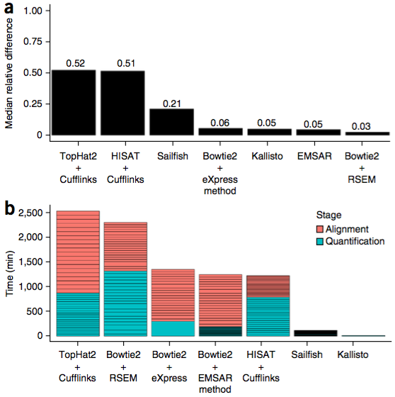
Quantification through pseudo-alignment
Quantification of gene expression doesn’t require knowing where a read originated from, but which transcripts could have generated it.
Kallisto
Fast and accurate.
Cannot discover new genes/transcripts/splice junctions.
Salmon is a similar program.
Accuracy
Speed
Patro et al., Nat Methods 14 (2017) doi.org/10.1038/nmeth.4197
Bray et al., Nat Biotech 34 (2016) doi.org/10.1038/nbt.3519
Notes:
- Kallisto -
Accurate quantification doesn’t require knowing where in the transcript a read originated from, but which transcripts could’ve generated it.
Fast by using k-mer exact matching through a hash table. Any k-mers overlapping sequencing errors won’t match and will be ignored.
A transcriptome de Bruijn graph (T-DBG) is used to determine which transcripts the read is compatible with.
The graph is built from k-mers of the transcriptome, each being a node.
A path covering the graph indicates the transcripts. The path induced multi-sets on the nodes; these are the compatibility classes.
An EM algorithm is applied to the equivalence classes to quantify expression.
Uncertainty on the quantification is assessed by bootstrapping.
- Salmon -
Fast quasi-mapping of reads.
Online phase: learns parameters to account for technical biases (positional biases in coverage, sequence-specific biases at the 5′ and 3′ ends of sequenced fragments, fragment-level GC bias, strand-specific protocols, and the fragment length distribution). With these it estimates the conditional probability of a fragment being generated from each transcript to which it maps.

Slide 21
Normalisation
To compare data from different samples, counts need to be normalised to remove systematic technical effects.
Sequencing depth bias: the most obvious difference between samples is how deep they are sequenced.
Larger libraries have larger counts. These need to be scaled to be comparable.
 | sample 1 | sample 2 | sample 3
gene 1 | 6 | 12 | 9
gene 2 | 10 | 20 | 15
gene 3 | 2 | 4 | 3
… | … | … | …
library size | 18 | 36 | 27
size factor | 1 | 2 | 1.5
 | sample 1 | sample 2 | sample 3
gene 1 | 6 | 6 | 6
gene 2 | 10 | 10 | 10
gene 3 | 2 | 2 | 2
… | … | … | …
library size | 18 | 18 | 18
counts
size factor

Slide 22
Normalisation
To compare data from different samples, counts need to be normalised to remove systematic technical effects.
Sequencing depth bias: the most obvious difference between samples is how deep they are sequenced.
Larger libraries have larger counts. These need to be scaled to be comparable.
Gene length bias: longer genes will also produce more reads.
Irrelevant when comparing across samples.
Important when comparing across genes, but these comparisons are difficult to interpret.

Slide 23
Measures of normalised counts
CPM – counts per million.
Sequencing depth normalisation.
RPKM – reads per kilobase per million mapped.
Sequencing depth and length normalisation.
FPKM – fragments per kilobase per million mapped.
Equivalent to RPKM but for paired end data, where both reads of the same fragment are only counted once.
TPM – transcripts per million
First normalise for length and then scale by library size.
Proportion of each transcript in the sample. All samples have the same normalised library size.

Slide 24
Normalisation
Composition biases: these arise when there is substantial differential expression of a set of transcripts.
Quantification is relative.
Increase in the expression of the blue gene leads to a proportional decrease in all other genes.
Changes in highly expressed genes can have a large impact on total library size.
FPKM normalisation becomes misleading.
gene counts
sample A
sample B

Slide 25
Normalisation
To account for sequencing depth and composition biases, size factors are calculated to normalise systematic differences between samples.
The assumption is that the majority of the transcriptome is not differentially expressed.
Therefore, any systematic differences must be technical.
Two popular methods:
Median-of-ratios (DESeq2).
Trimmed mean of M values (edgeR).
Anders and Huber, Genome Biology 11 (2010) doi.org/10.1186/gb-2010-11-10-r106
Robinson and Oshlack, Genome Biology 11 (2010) doi.org/10.1186/gb-2010-11-3-r25

Slide 26
Normalisation – DESeq2
counts
size factors
 | sample 1 | sample 2 | sample 3
gene 1 | 45 | 88 | 66
gene 2 | 1268 | 5072 | 3804
gene 3 | 2 | 4 | 3
… | … | … | …
gene n-2 | 6 | 11 | 8
gene n-1 | 740 | 1470 | 1101
gene n | 39 | 26 | 19.5
library size | 1 | 2 | 1.5
pseudo-ref
63.94
2903
2.88
…
8.08
1061.97
27.04
 | sample 1 | sample 2 | sample 3
gene 1 | 0.70 | 1.38 | 1.03
gene 2 | 0.44 | 1.75 | 1.31
gene 3 | 0.69 | 1.39 | 1.04
… | … | … | …
gene n-2 | 0.74 | 1.36 | 0.99
gene n-1 | 0.70 | 1.38 | 1.04
gene n | 1.44 | 0.96 | 0.72
median | 0.70 | 1.38 | 1.04
nonDE gene
DE gene
1. Construct a pseudo-reference by taking the geometric mean of each gene across samples.
2. Compute the fold-change of each sample over the pseudo-reference.
3. Take the median of the fold-changes as the size factors to scale the counts.
- The median protects against DE genes.
Anders and Huber, Genome Biology 11 (2010) doi.org/10.1186/gb-2010-11-10-r106

Slide 27
Batch effects
Once the data has been normalised, it is useful to have an initial quick look at the overall transcriptomes.
Make sure samples from different conditions behave as expected.
Check if there are still systematic technical effects.
Sample distance heatmap
MDS plot
PCA plot
distance
Tumour Normal
treated-SE
treated-PE
treated-PE
untreated-SE
untreated-SE
untreated-PE
untreated-PE
51T
51N
patient
51
8
33
1
2
3
batch
Leading logFC dim2
PC2
8T
8N
33T
33N
Leading logFC dim1
PC1
Modified from: http://bioconductor.org/packages/devel/bioc/vignettes/DESeq2/inst/doc/DESeq2.html
http://bioconductor.org/packages/release/bioc/vignettes/edgeR/inst/doc/edgeRUsersGuide.pdf
https://pachterlab.github.io/sleuth_ walkthroughs/bottomly/analysis.html
Notes:
Possible sample swaps.
Library size should no longer be a factor, but other batch effects could be present.

Slide 28
Differential expression
One of the main applications of RNA-seq is to compare samples under different conditions.
Healthy vs diseased.
Control vs exposure to treatment/drug/condition.
Wild-type vs gene knockout.
Changes across development/ageing.
Differential expression analysis assesses whether the difference in expression levels between groups is larger than quantification error.
quantification error
difference between biological conditions
gene expression
C
T

Slide 29
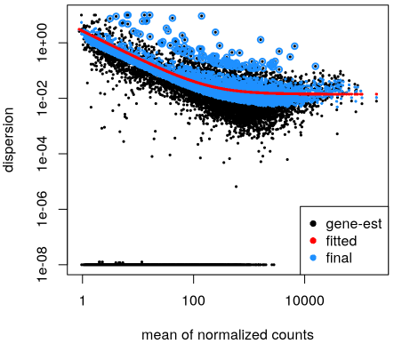
Differential expression
The low number of replicates makes estimating the variation accurately very difficult.
This is overcome by pooling information across genes, to make estimates more robust.
There is a strong relationship between the mean expression level and the dispersion.
Genes expressed at lower levels are more variable.
This relationship is not preserved after normalisation.
Always use raw counts for DE testing.
dispersion
mean normalized counts
http://bioconductor.org/packages/devel/bioc/vignettes/DESeq2/inst/doc/DESeq2.html
Notes:
Pooling across genes makes the assumption that variances are similar for different genes from the same experiment.
Biological noise is higher for lowly expressed genes.

Slide 30
Differential expression
There are many programs to perform differential expression analysis.
DESeq2
edgeR
limma-voom
sleuth (can use output from kallisto and perform DE analysis at the transcript level)
It is possible to account for complex experimental designs and control for batch effects and confounding factors.
extensive documentation
https://www.bioconductor.org/packages/release/bioc/html/DESeq2.html
http://bioconductor.org/packages/release/bioc/html/edgeR.html
http://bioconductor.org/packages/release/bioc/html/limma.html
Notes:
Kallisto quantifies expression at the transcript level, but defining compatibility classes, and therefore sets of transcripts.

Slide 31
Interpretation of results
What to do when you have a list of differentially expressed genes:
If you already have a hypothesis, test it.
Perform gene set enrichment analysis (GSEA, TopGO, InnateDB, Ingenuity Pathway Analysis, etc.)
Work through the list, google, read papers.
Cross-reference with other features/datasets: Pfam domains, chromosomal location, proteome, correlation with ChIP-seq / mutation / GWAS hits…
Make new hypotheses.
Go back to the lab.

Slide 32
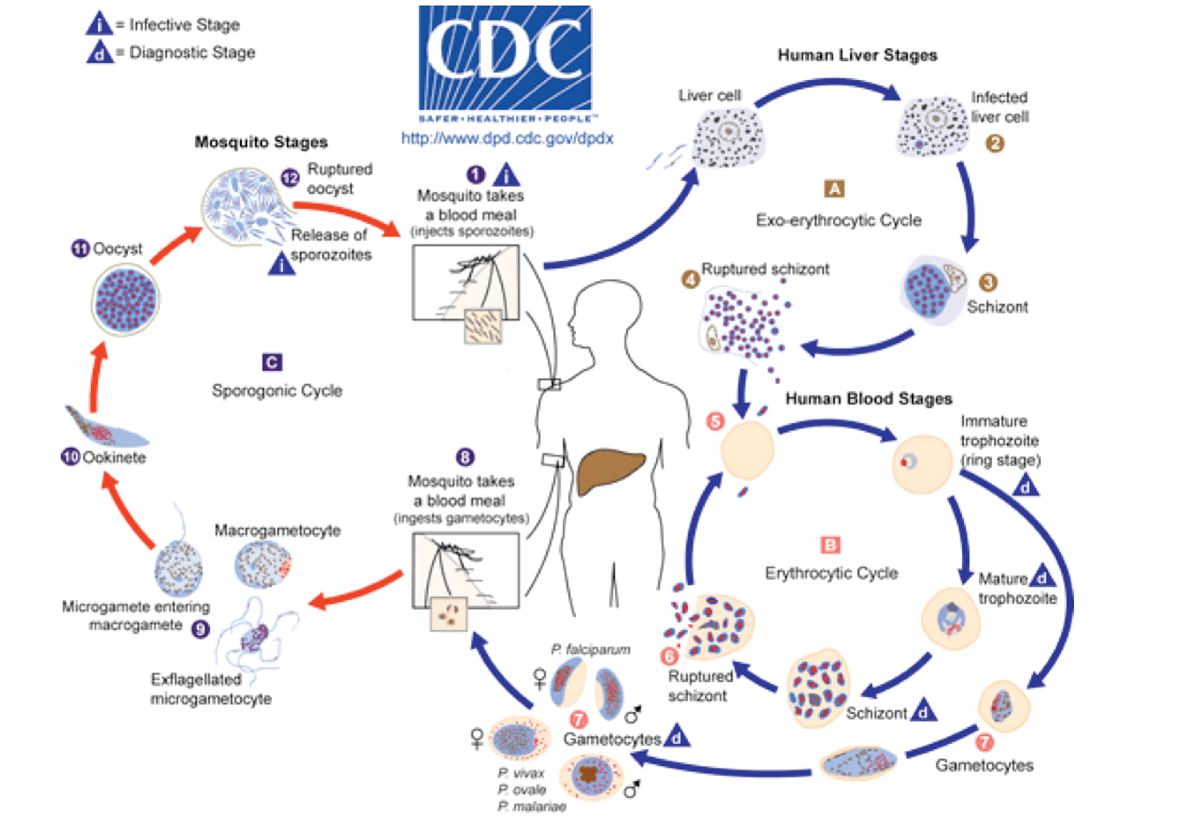
The exercise
Plasmodium chabaudi: a rodent malaria parasite.
Exhibits many characteristic associated with the pathogenesis of human infection.
Serial blood passage (SBP).
Direct injection from mouse to mouse.
Severe disease.
Infection with parasite via mosquitos (MT).
Lower parasitaemia (presence of parasites in the blood).
Mild, chronic disease.
Spence et al., Nature 498 (2013) doi.org/10.1038/nature12231
IS THE TRANSCRIPTOME OF MOSQUITO TRANSMITTED PARASITES DIFFERENT FROM ONE WHICH HAS NOT PASSED THROUGH A MOSQUITO?
Notes:
Plasmodium is a parasite which causes malaria has a complicated lifecycle
Transmitted to humans only via mosquito vectors
During a blood meal, a malaria-infected female Anopheles mosquito inoculates sporozoites into the human host
these sporozoites infect liver cells
mature into schizonts
which rupture and release merozoites
Parasites multiply and infect red blood cells
ring stage trophozoites mature into schizonts, which rupture releasing merozoites (keep going round cycle)
Some differentiate gametocytes
Gametocytes are ingested by an Anopheles mosquito during a blood meal
Reproduce in the mosquito gut
Parasites then migrate to the salivary glands and are eventually injected into another human in a subsequent bite.
Plasmodium chabaudi (P.c.)
a rodent malaria parasite that exhibits many characteristics associated with the pathogenesis of human infection
Mice infected with P. chabaudi by serial blood passage (direct injection from mouse to mouse, bypassing the natural route) suffered from severe malaria (SBP)
Mice infected with parasites via mosquitoes developed a lower parasitaemia (presence of parasites in the blood) and a mild, chronic disease (MT)
Is the transcriptome of the mosquito-transmitted parasite different from one which has not passed through a mosquito?

